Slide 1

AML-2203 Advanced Python AI and ML Tools
Lambton College
School of Computer Studies

Slide 2
Module 6
6. Evaluate Python modules to work with images and create visualization (Recommended Module: OpenCV, and Plotly)
Major Topics:
6.1 Discuss image data and their characteristics
6.2 Use Python modules to load, resize, crop, and save images
6.3 Use Python modules to visualize data sets
6.4 Use Python modules to visualize linear regression

Slide 3
6.1 Discuss image data and their characteristics

Slide 4
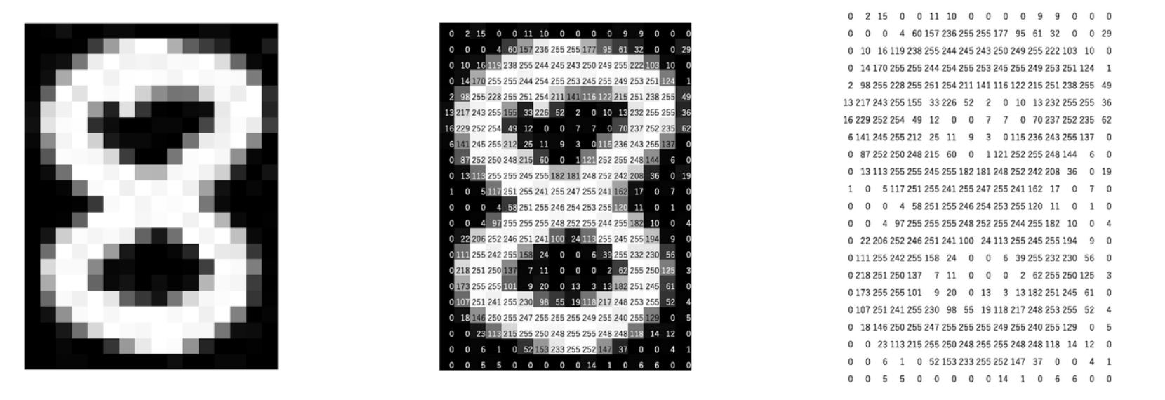
Image data
Handling images, especially image classification is one of the common areas of machine learning.
Machines store images in the form of a matrix (or matrices for colored images) of numbers, and do the computation on it.
The size of this matrix depends on the number of pixels we have in any given image.
A colored image is typically composed of multiple colors (multiple matrices).
Almost all colors can be generated from three primary colors – red, green and blue (a matrix for each color)

Slide 5
6.2 Use Python modules to load, resize, crop, and save images

Slide 6
Loading images
OpenCV is the most popular and documented library for handling images.
We use cv2.imread() to load the images.
It needs the path to image and the flag
Flag: It specifies the way in which image should be read.
cv2.IMREAD_COLOR: loading a color image.
cv2.IMREAD_GRAYSCALE: loading an image in grayscale mode.
cv2.IMREAD_UNCHANGED: loading an image as such including alpha channel.
OpenCV works with BGR ordering (blue, green and red) while most of the other libraries (e.g. matplotlib) work with RGB (red, green and blue).
We need to convert BGR to RGB using cv2.cvtColor() after loading the image.

Slide 7
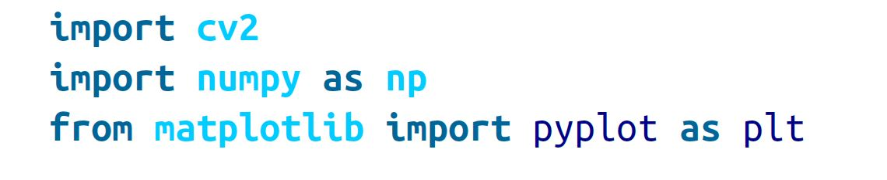
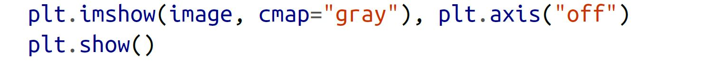
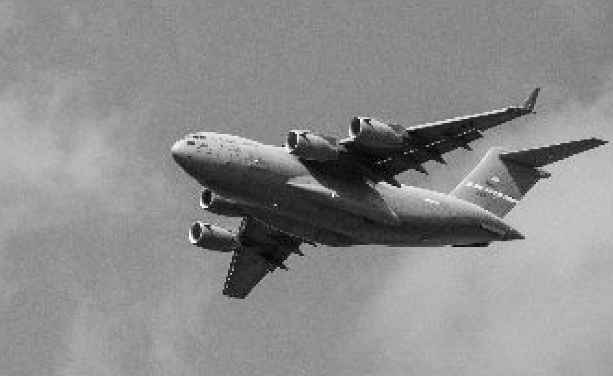
Loading images-grayscale

Slide 8
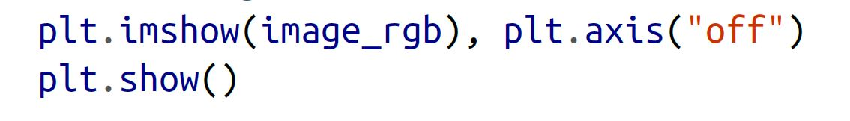
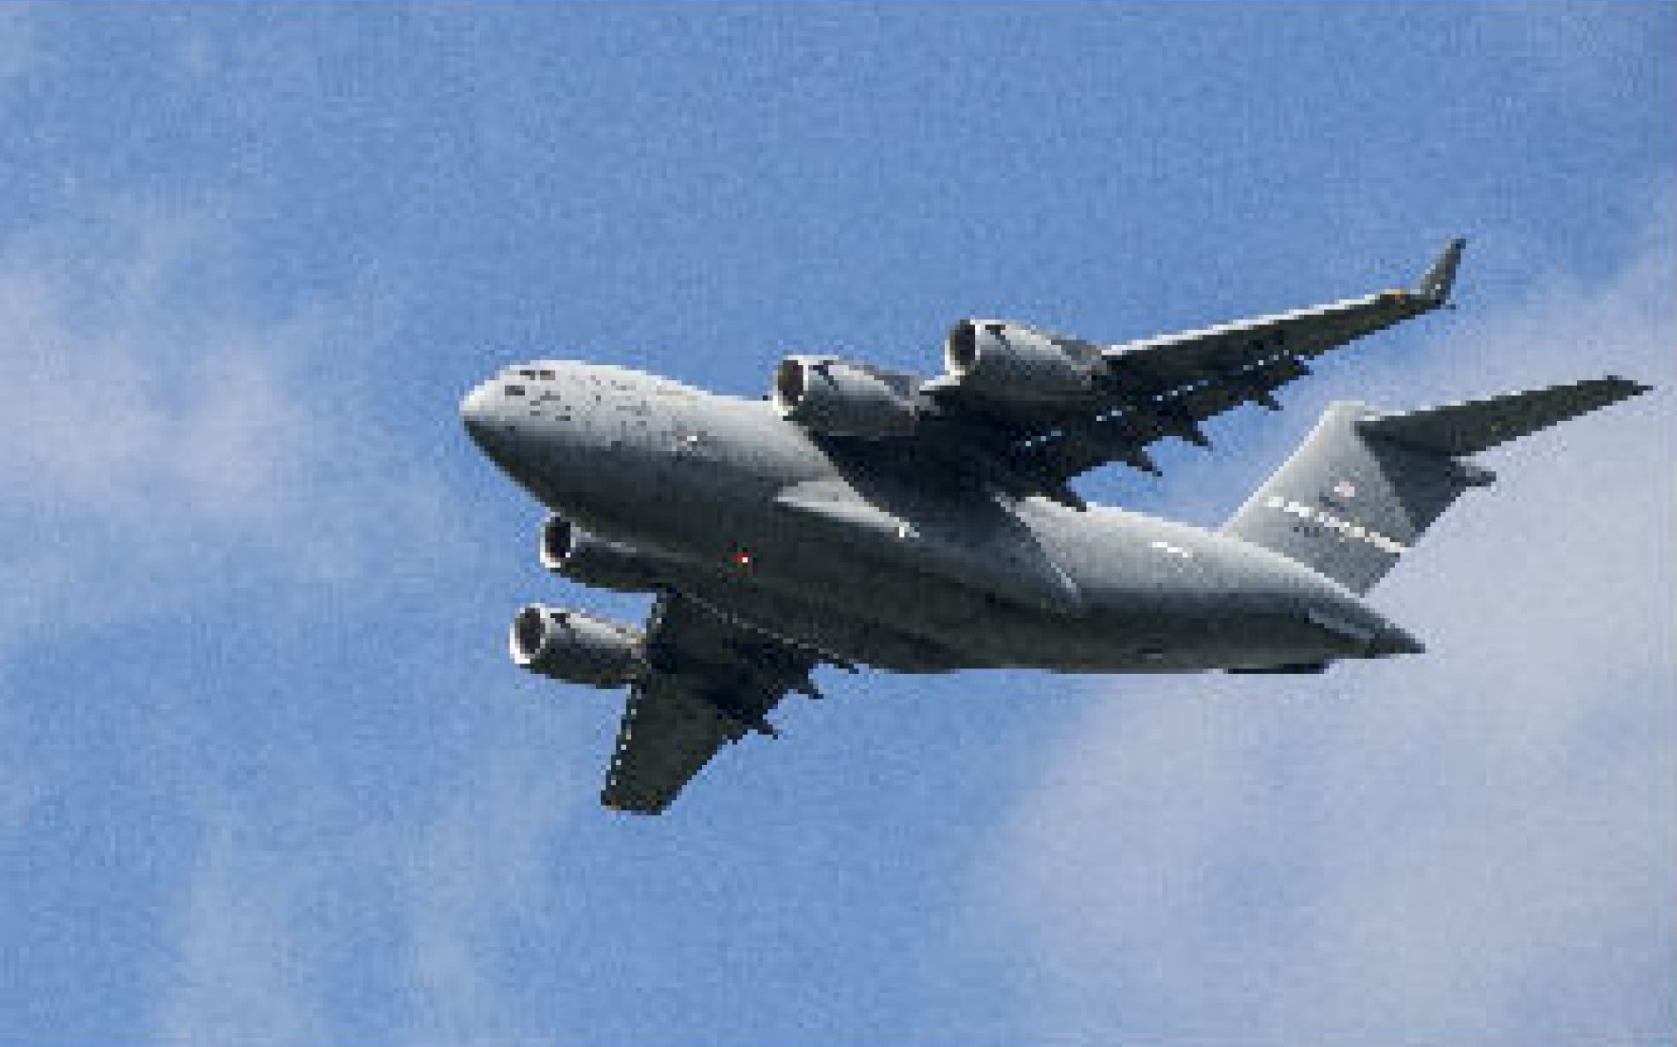
Loading images-color

Slide 9
Use Python modules to resize image

Slide 10
Resizing images
Resizing images is a common task in image preprocessing:
Images come in all shapes and sizes.
To be usable as features, images must have the same dimensions.
Cost of resizing:
Images are matrices of information and when we reduce its size, we are reducing the size of that matrix and the information it contains
We resize images using .resize().

Slide 11
Use Python modules to crop images

Slide 12
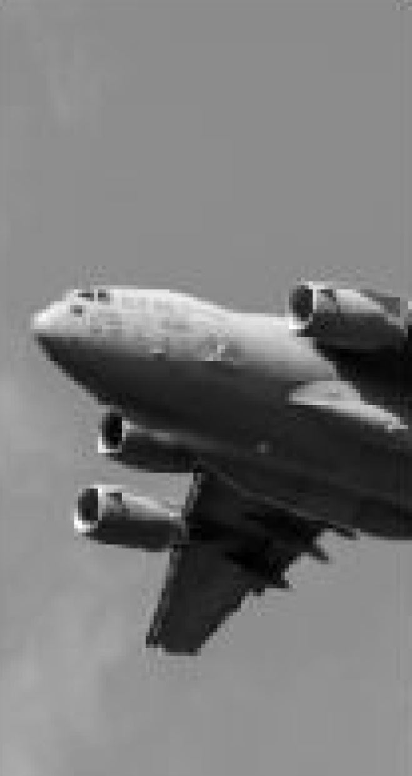
Cropping images
We can crop an image by selecting the columns and rows we want to keep.
Cropping can be useful if we know that we only want to keep a certain part of every image.

Slide 13
Use Python modules to save images

Slide 14
Saving images
OpenCV’s imwrite saves images to the filepath specified.
The format of the image is defined by the filename’s extension (.jpg, .png, etc.).

Slide 15
Any questions so far? Any comments?

Slide 16
6.3 Use Python modules to visualize data sets

Slide 17
Seaborn
Unlike Matplotlib, Seaborn is not a standalone Python library.
It is built on top of Matplotlib and provides a higher-level abstraction to make visually appealing statistical visualizations.
The most prominent features of Seaborn are as follows:
Beautiful out of the box plots with different themes
Built-in color palettes that can be used to reveal patterns in the dataset

Slide 18
Seaborn
It uses fewer syntax and has easily interesting default themes.
While Matplotlib is highly customizable and powerful, Seaborn avoids a ton of boilerplate by providing default themes which are commonly used.
A neat feature of Seaborn is the ability to integrate with DataFrames from the pandas library.
Seaborn works with the dataset as a whole and is much more intuitive than Matplotlib.
In Seaborn, replot() is the entry API with ‘kind’ parameter to specify the type of plot which could be line, bar, or many of the other types (default scatter).

Slide 19
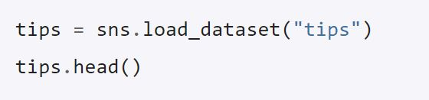
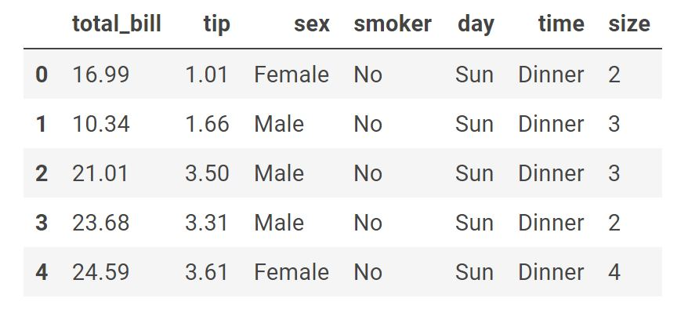
Seaborn
Seaborn needs to imported.

Slide 20
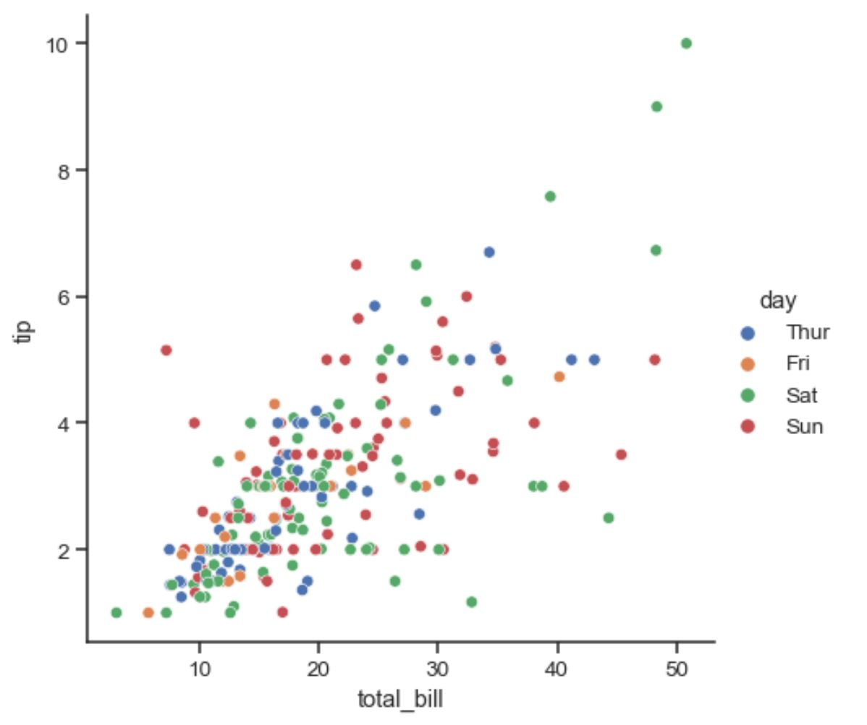
Seaborn

Slide 21
Plotly
Plotly is a plotting ecosystem that allows you to make plots in Python, as well as JavaScript and R.
By using matplotlib or seaborn, we can only create static image files (jpeg or png or any static image format).
What makes Plotly different is that it supports JavaScript, so it will respond to mouse events.
Users can interact with these plots (by zooming in, selecting particular area within plot for detailed analysis and hover-across the plot, etc..).

Slide 22

Plotly exxpress
Plotly Express is a new high-level Python visualization library.
We need to import plot express as follows:
Plotly express has built-in datasets.

Slide 23
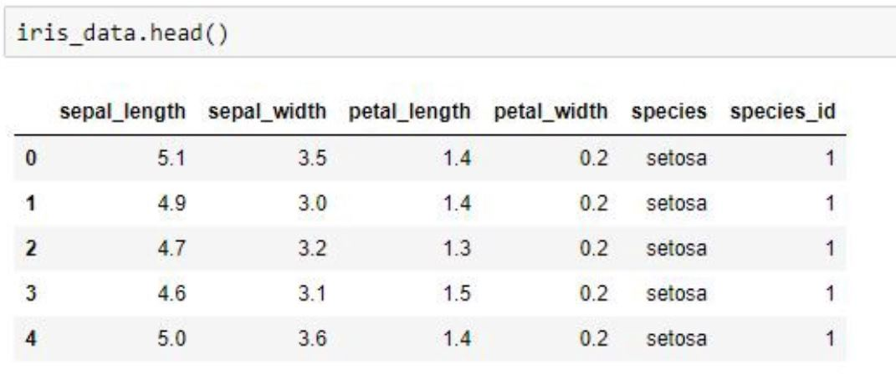
Plotly exxpress

Slide 24
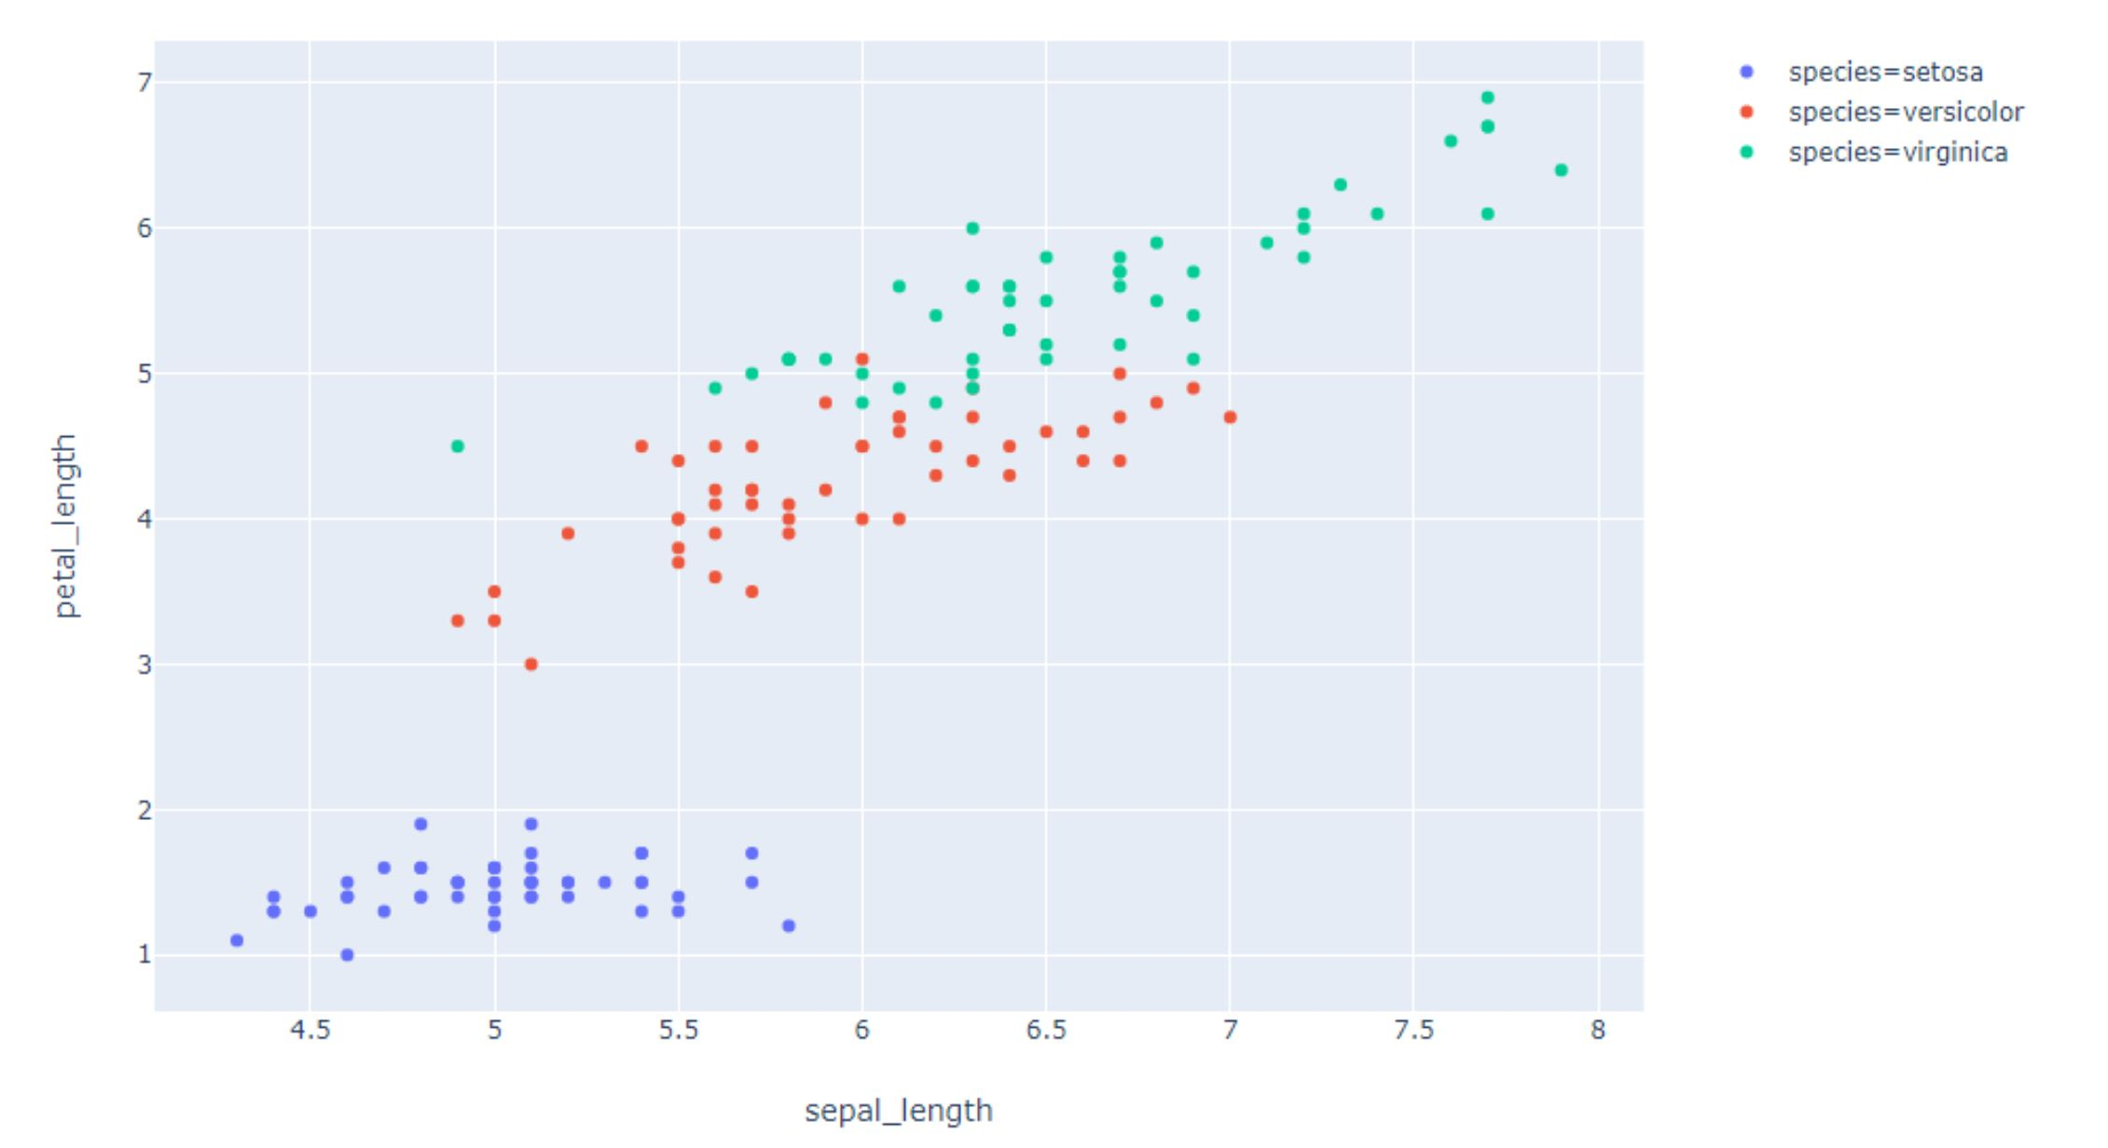
Plotly exxpress

Slide 25
6.4 Use Python modules to visualize linear regression

Slide 26

Linear regression with seaborn
The main function in seaborn used to visualize a linear relationship is regplot().
regplot() accepts the x and y variables in a variety of formats including simple numpy arrays, pandas Series objects, or as references to variables in a pandas DataFrame object passed to data.

Slide 27
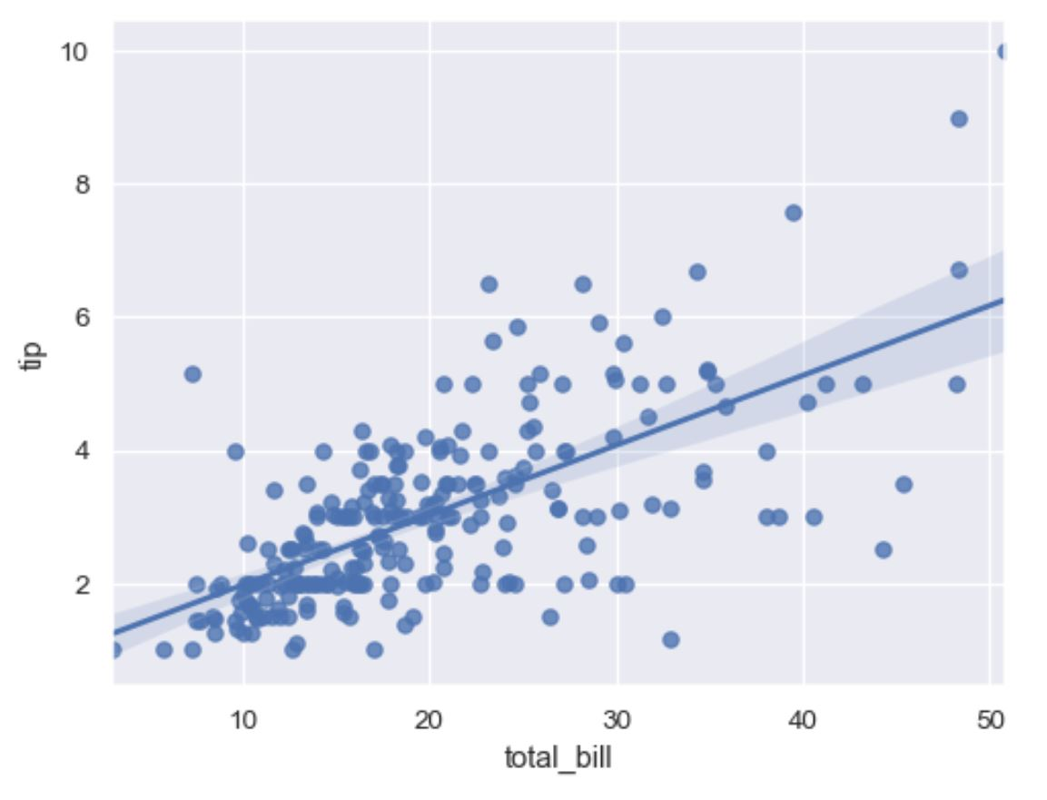
Linear regression with seaborn

Slide 28

Linear regression with plotly
We can use ‘trendline’ parameter in scatter plot on plotly express to fit a line on our data.
In order to do so, you will need to install statsmodels and its dependencies.
There are different options to select from for trendline.
Ordinary least square (ols) is the most common option for trendline.

Slide 29
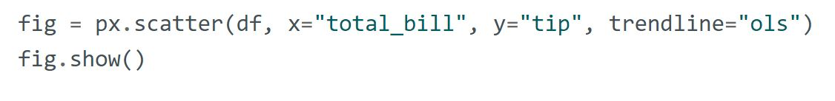
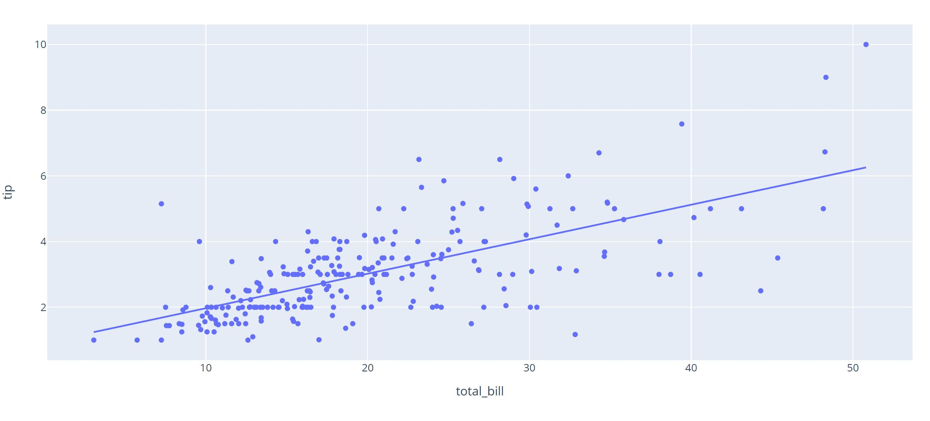
Linear regression with plotly

Slide 30
Any questions so far? Any comments?

